Slide 1
Mingle & Breakfast
Breakfast- Help yourself to some breakfast. There is Dunkin Donuts on the table.
Connect to Wifi- Please connect to the Wi-Fi Network so we are all ready to begin. The network is hackathon the password is Hackathon2023
Mingle and Meet People- Feel free to introduce yourself other people interested in coding (soldiers and civilians alike). You can make teams of up to three people.
We will begin at 9:30

Slide 2
Introductions
CPT Christopher Flournoy
1LT Patrick Shea
SFC Nathan Lopez
SSG Walter Castillo
SPC Malakhi Perry
PVT Salem Ezz
Special Thanks to Ms. Catherine Blake with Georgia Southern, CMI2, and NSIN.

Slide 3
Schedule
0900 – 0930: Arrival and Breakfast
0930 – 1000: Hackathon Overview
1000 – 1200: Morning Breakout
1200 – 1300: Walkthrough Lunch
1300 – 1515: Afternoon Breakout
1515 – 1545: Team Presentations
1545 – 1600: Closeout

Slide 4
Different Problems
ODST
Mapping Frontline Traces
Graphical Firing Table
Pick your own

Slide 5
ODST
Background- Orders in the military are the official way to task units. Current methods of orders dissemination include long email chains and distros that are hardly accurate.
Solution- 18th ABC has created a tool to simplify the orders process but still needs help with functions to improve the app. Functions that still need work:
A search method that will search through folders and files with the relevant information sorted by time
A text recognition function for JPEG or other image files

Slide 6
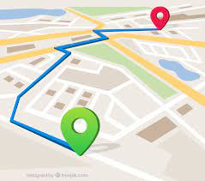
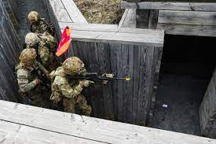
Frontline Trace
Background- Part of the job of infantry units is to clear trench lines. Commanders and support by fire units need to know where the assaulting unit has cleared as well as where they are currently in order to adjust and lift fire.
Solution- Create a function that takes GPS coordinates from Arduino and uses a map mod to display a where the unit has been as well as show where the unit currently is.
Stretch- Display the current coordinates in MGRS format

Slide 7
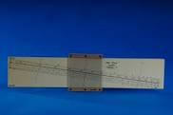
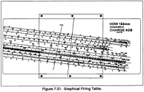
Graphical Firing Table (GFT)
Background- Field Artillery units have to be able to calculate firing data manually. One method is to use a “slide ruler” called a GFT. GFT’s break consistently, are easily lost, and are hard to replace making training difficult.
Solution- Create a GUI that allows a front picture to slide left and right over a background picture as well as allows the user to draw and erase lines on the slider

Slide 8
Judging
At the end of the competition all groups will have five minutes to pitch the idea, the capability . The order of groups will be chosen at random. Groups will be graded on the following criteria:
Army Capability Gap(s) – 25%
Code Readability and Efficiency– 25%
Pitch Quality and Ability to Communicate – 25%
Architectural Decision – 25%

Slide 9
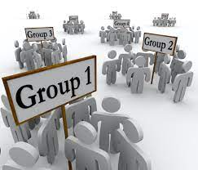
Breakout
Please select your teams and submit to the judges
Don’t be afraid to ask questions!

